Slide 1
Connecting App with Backend
Lesson 9

Slide 2
Lesson Objectives
Connect a React Native app to a backend API
Fetch data from a server
Send data to the server
Update and delete data
Implement CRUD operations

Slide 3
What is an API?
API = Application Programming Interface
It allows applications to communicate with a server.
Example:
Mobile App → API Server → Database
In our case:
React Native → Node.js Express API → Neon PostgreSQL

Slide 4
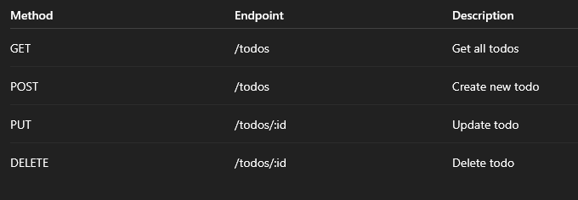
Our Todo API Endpoints
Base URL “http://localhost:5000/todos”

Slide 5
Important for React Native
Android emulator “http://10.0.2.2:5000/todos”
iOS simulator “http://localhost:5000/todos”
Real phone
Use your computer IP: “http://192.168.x.x:5000/todos”

Slide 6
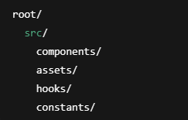
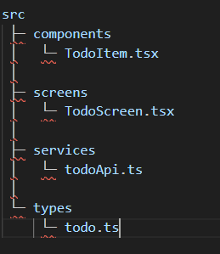
Current Directory
screens/ → full pages like Todo screen
components/ → reusable UI like TodoItem
navigation/ → stack/tab setup
services/ → API calls
hooks/ → optional custom hooks later
utils/ → constants/helpers

Slide 7
Getting started
Create API config
2. Create API service
3. Create reusable Todo item component
4. Create the main Todo screen

Slide 8
Create Todo types “src/types/todo.ts”
export type Todo = {
id: number;
title: string;
completed: boolean;
};

Slide 9
Create API config
Create:
src/utils/config.js
export const API_URL = "http://10.0.2.2:5000/todos";
Use:
10.0.2.2 for Android emulator
localhost for iOS simulator/web
your laptop IP for real device

Slide 10
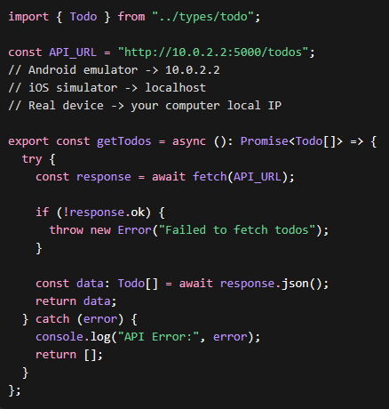
Create API service “src/services/todoApi.js”
Notes:
import { Todo } from "../types/todo";
const API_URL = "http://10.0.2.2:5000/todos";
// Android emulator -> 10.0.2.2
// iOS simulator -> localhost
// Real device -> your computer local IP
export const getTodos = async (): Promise<Todo[]> => {
try {
const response = await fetch(API_URL);
if (!response.ok) {
throw new Error("Failed to fetch todos");
}
const data: Todo[] = await response.json();
return data;
} catch (error) {
console.log("API Error:", error);
return [];
}
};

Slide 11
Create a reusable Todo item component
src/components/TodoItem.tsx
import { StyleSheet, Text, View } from "react-native";
import { Todo } from "../types/todo";
type TodoItemProps = {
todo: Todo;
};
export default function TodoItem({ todo }: TodoItemProps) {
return (
<View style={styles.item}>
<Text style={styles.title}>{todo.title}</Text>
<Text style={styles.status}>
{todo.completed ? "Completed" : "Not completed"}
</Text>
</View>
);
}
const styles = StyleSheet.create({
item: {
backgroundColor: "#fff",
padding: 15,
borderRadius: 10,
marginBottom: 10,
},
title: {
fontSize: 16,
fontWeight: "bold",
marginBottom: 4,
},
status: {
color: "gray",
},
});

Slide 12
Create the screen “src/screens/TodoScreen.tsx”
import { useEffect, useState } from "react";
import {
ActivityIndicator,
FlatList,
SafeAreaView,
StyleSheet,
Text,
} from "react-native";
import TodoItem from "../components/TodoItem";
import { getTodos } from "../services/todoApi";
import { Todo } from "../types/todo";
export default function TodoScreen() {
const [todos, setTodos] = useState<Todo[]>([]);
const [loading, setLoading] = useState<boolean>(true);
const fetchTodos = async () => {
const data = await getTodos();
setTodos(data);
setLoading(false);
};
useEffect(() => {
fetchTodos();
}, []);
if (loading) {
return (
<SafeAreaView style={styles.loaderContainer}>
<ActivityIndicator size="large" />
</SafeAreaView>
);
}
return (
<SafeAreaView style={styles.container}>
<Text style={styles.heading}>Todo List</Text>
<FlatList
data={todos}
keyExtractor={(item) => item.id.toString()}
renderItem={({ item }) => <TodoItem todo={item} />}
ListEmptyComponent={<Text style={styles.empty}>No todos found.</Text>}
/>
</SafeAreaView>
);
}
const styles = StyleSheet.create({
loaderContainer: {
flex: 1,
justifyContent: "center",
alignItems: "center",
},
container: {
flex: 1,
padding: 20,
backgroundColor: "#f2f2f7",
},
heading: {
fontSize: 28,
fontWeight: "bold",
marginBottom: 20,
},
empty: {
textAlign: "center",
marginTop: 20,
color: "gray",
},
});

Slide 13
Connect the screen to navigation
import { useEffect, useState } from "react";
import {
ActivityIndicator,
FlatList,
SafeAreaView,
StyleSheet,
Text,
} from "react-native";
import TodoItem from "../components/TodoItem";
import { getTodos } from "../services/todoApi";
import { Todo } from "../types/todo";
export default function TodoScreen() {
const [todos, setTodos] = useState<Todo[]>([]);
const [loading, setLoading] = useState<boolean>(true);
const fetchTodos = async () => {
const data = await getTodos();
setTodos(data);
setLoading(false);
};
useEffect(() => {
fetchTodos();
}, []);
if (loading) {
return (
<SafeAreaView style={styles.loaderContainer}>
<ActivityIndicator size="large" />
</SafeAreaView>
);
}
return (
<SafeAreaView style={styles.container}>
<Text style={styles.heading}>Todo List</Text>
<FlatList
data={todos}
keyExtractor={(item) => item.id.toString()}
renderItem={({ item }) => <TodoItem todo={item} />}
ListEmptyComponent={<Text style={styles.empty}>No todos found.</Text>}
/>
</SafeAreaView>
);
}
const styles = StyleSheet.create({
loaderContainer: {
flex: 1,
justifyContent: "center",
alignItems: "center",
},
container: {
flex: 1,
padding: 20,
backgroundColor: "#f2f2f7",
},
heading: {
fontSize: 28,
fontWeight: "bold",
marginBottom: 20,
},
empty: {
textAlign: "center",
marginTop: 20,
color: "gray",
},
});

Slide 14
Next Step

